Slide 1

Ayur-Aroghya
N.Bhanu Siva Prakash

Slide 2
Contents
Abstract
Tools Handled
Database Schema
Project Flow Algorithm

Slide 3
Abstract
Our E-commerce platform project related to medical purchase, our project Titled-”Ayur-Aroghya”.
Now-a-days E-commerce is very needful to everyone and can save money and time for consumers.

Slide 4

Tools Handled
MySQL Workbench 8.0 CE,
Spring Tool Suite 4,
Visual Studio Code V.1.70.2
Angular CLI V.14.1.1
Node JS V.16.16.0

Slide 5
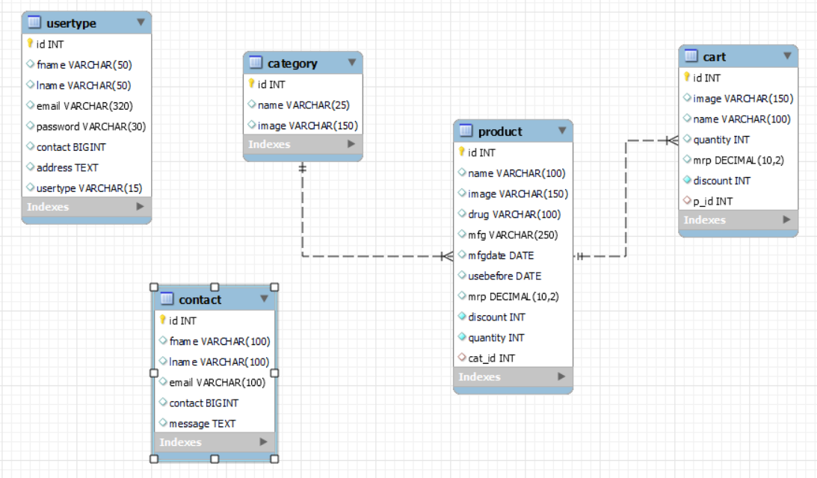
Database Schema

Slide 6
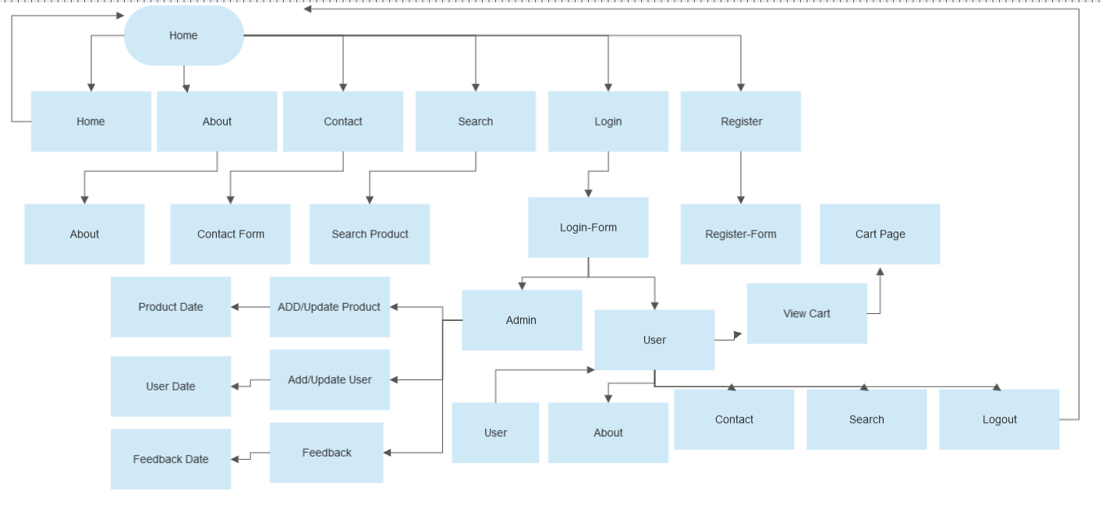
Project Flow Algorithm

Slide 7
Conclusion
In these days making your Business available online is crucial to your Business due to online booking having more demand than the local market people like to buy online because more Furniture and different models are available with less cost and door delivery.
There is no reach and limitations for the online is open source to buy furniture we can advertise our favorite brands and make the customer happy.

Slide 8
Thank you
N.Bhanu Siva Prakash
nagarajubhanuprakash@gmail.com+91-9885533414

